Slide 1
The SCARAB
Stuart Rossiter
C00284845
October 2025

Slide 2
Problem
Hardware decays over time
Issues go undiscovered
Focus is primarily on software preservation
Retro cartridges need help
Too much variety of cartridges

Slide 3
Problem
Hardware decays over time
Issues go undiscovered
Focus is primarily on software preservation
Retro cartridges need help
Too much variety of cartridges

Slide 4
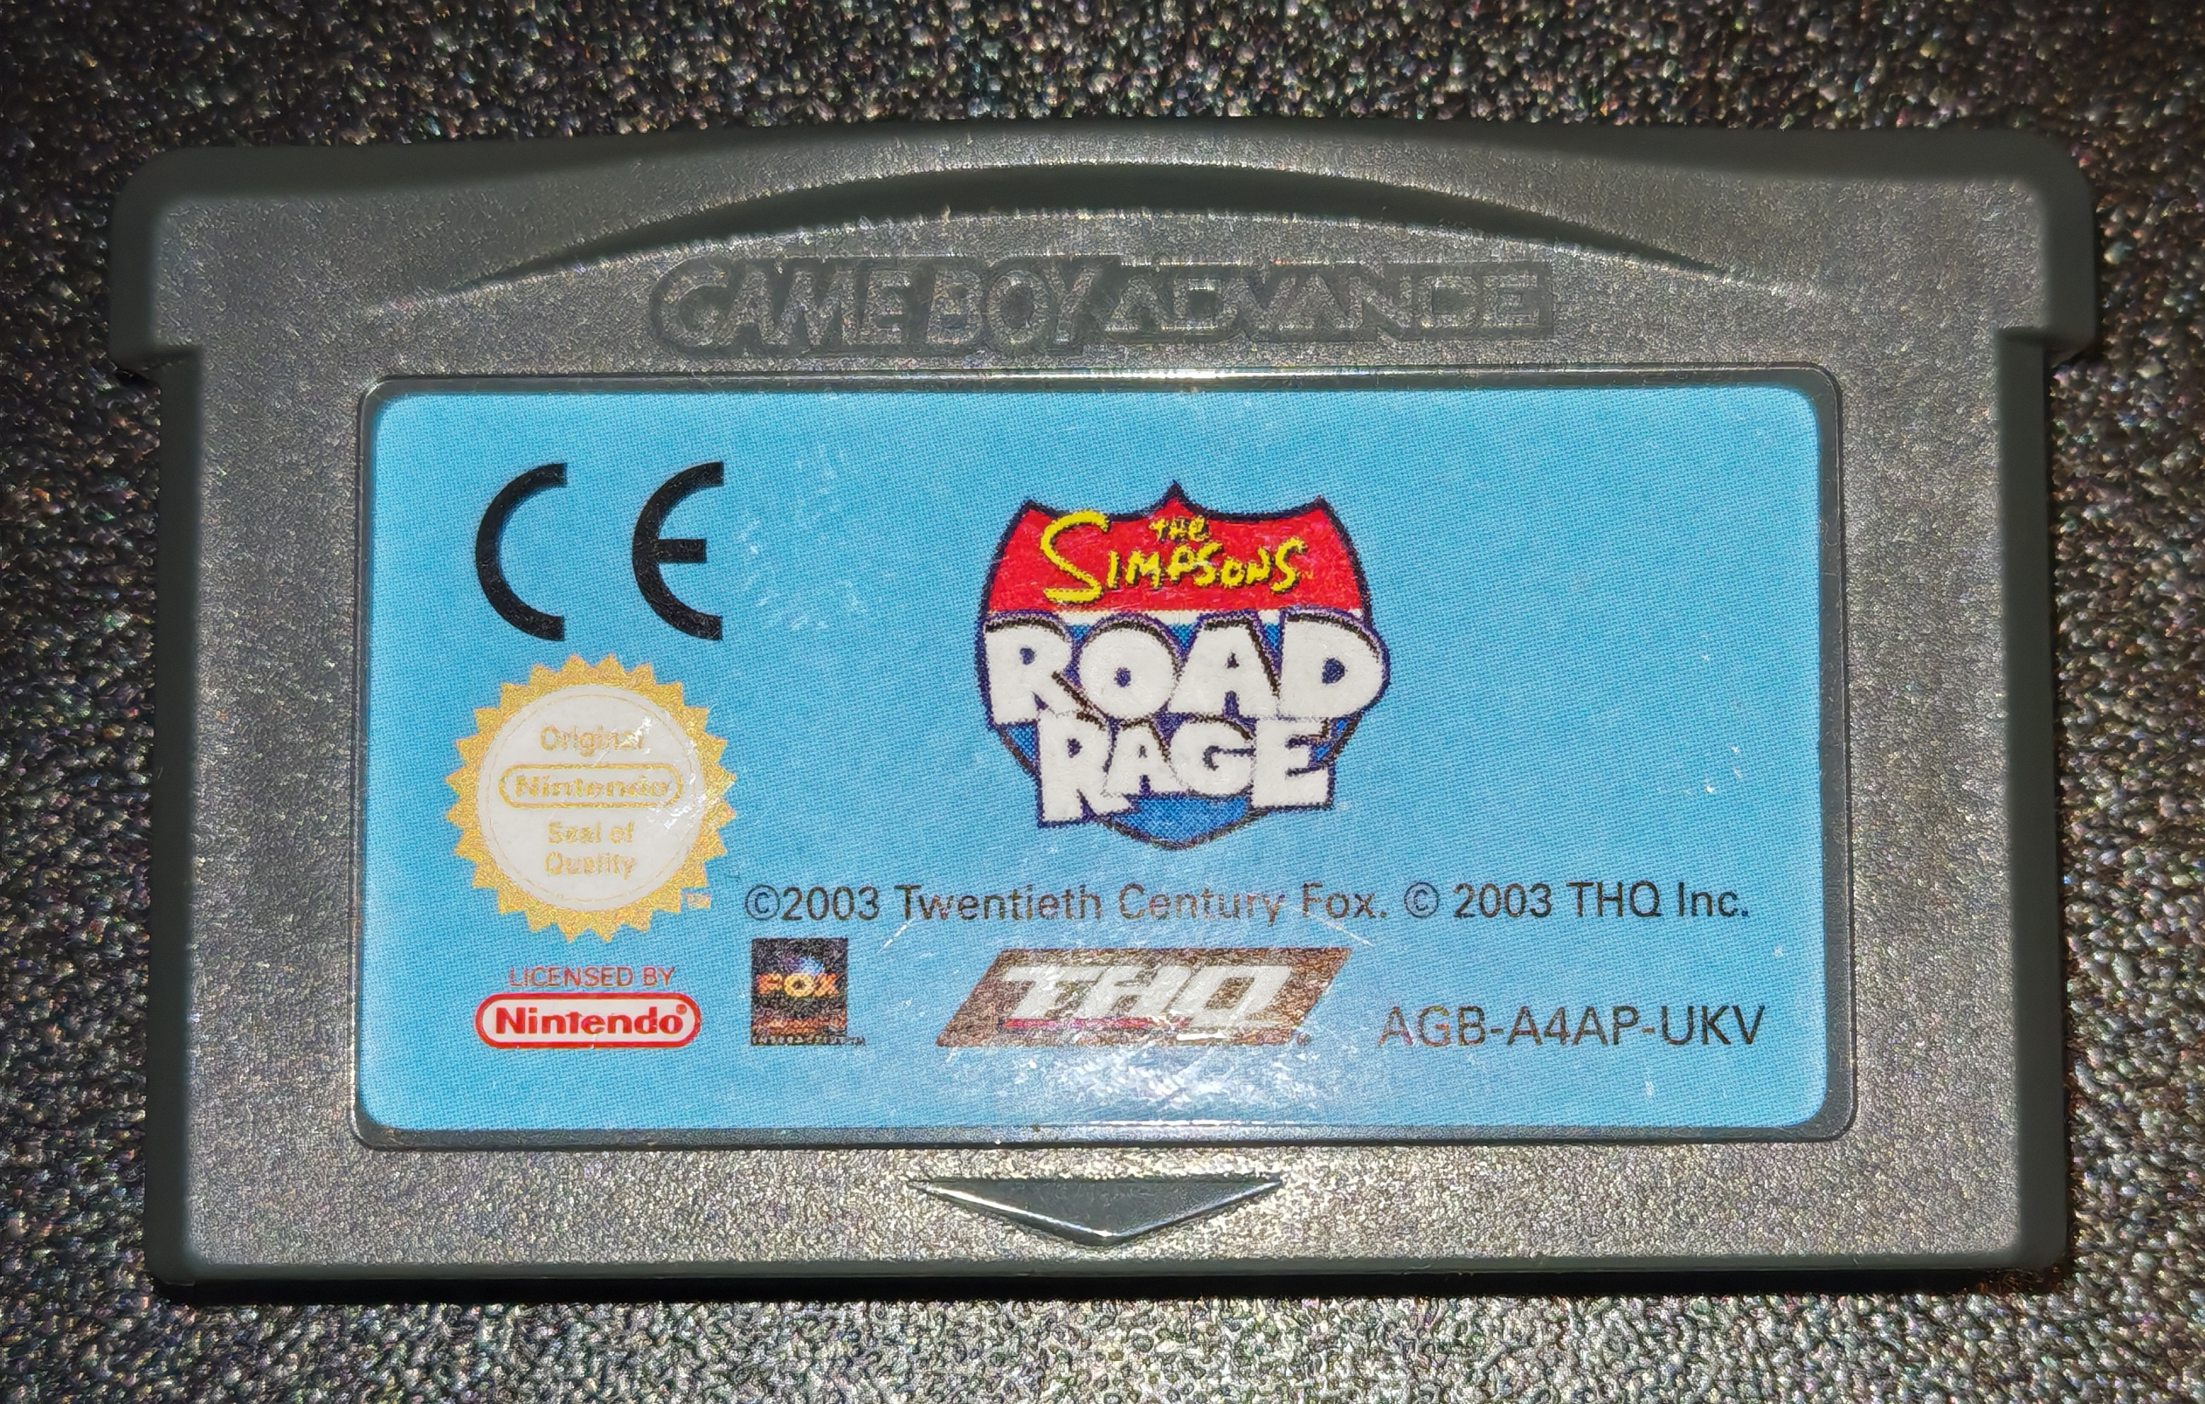
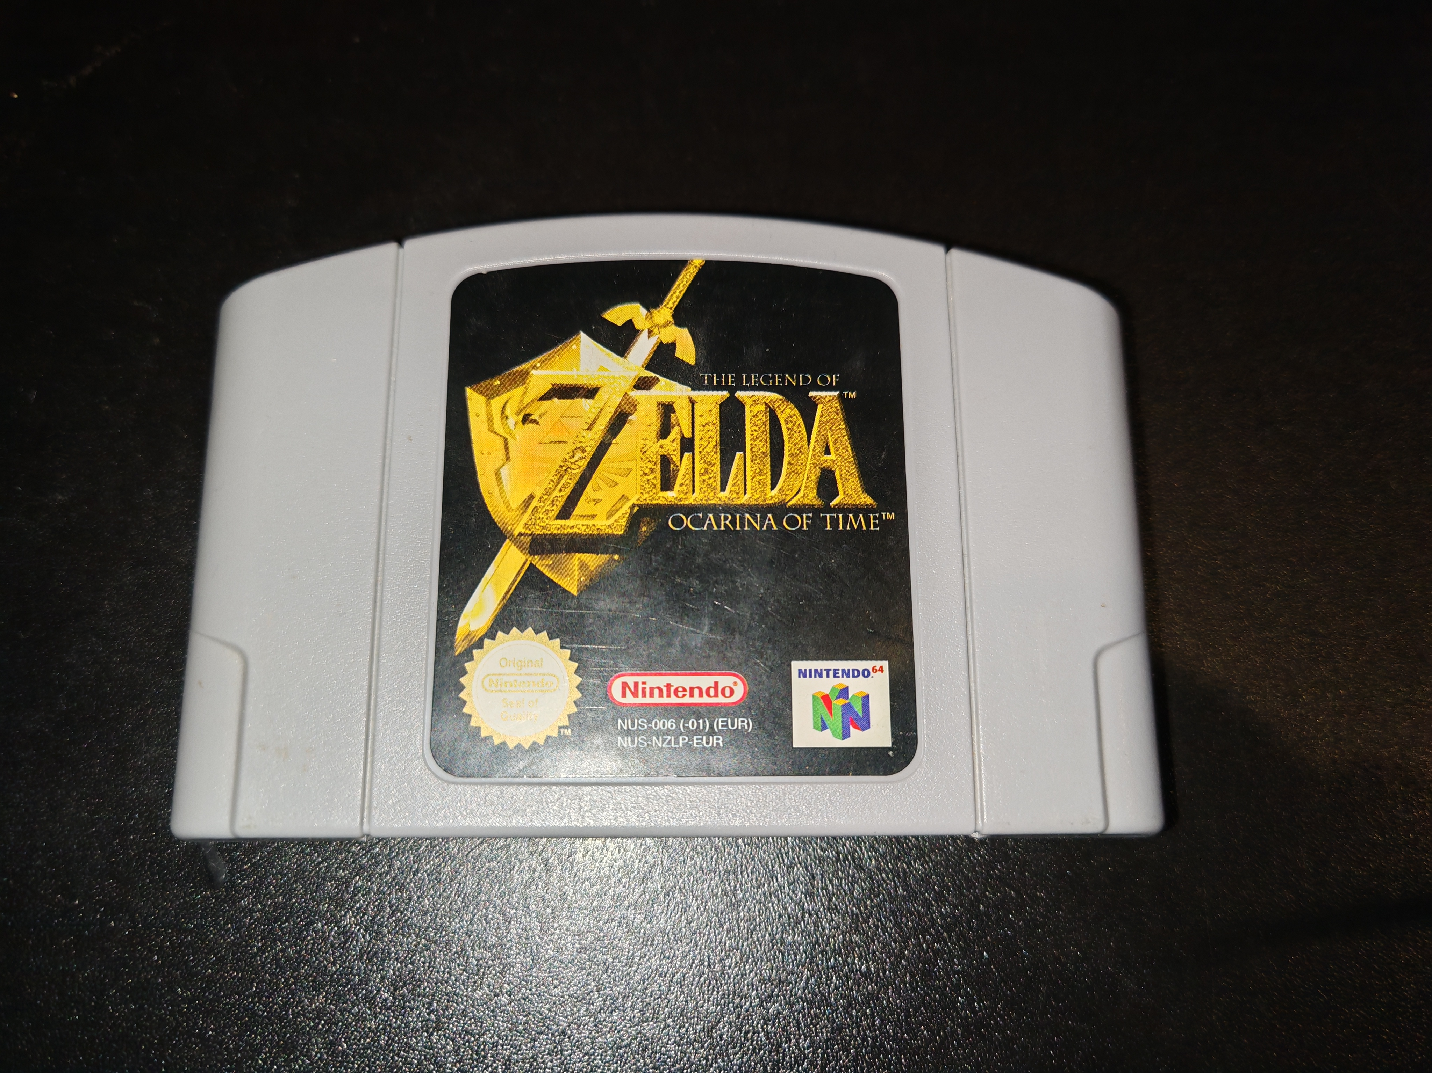
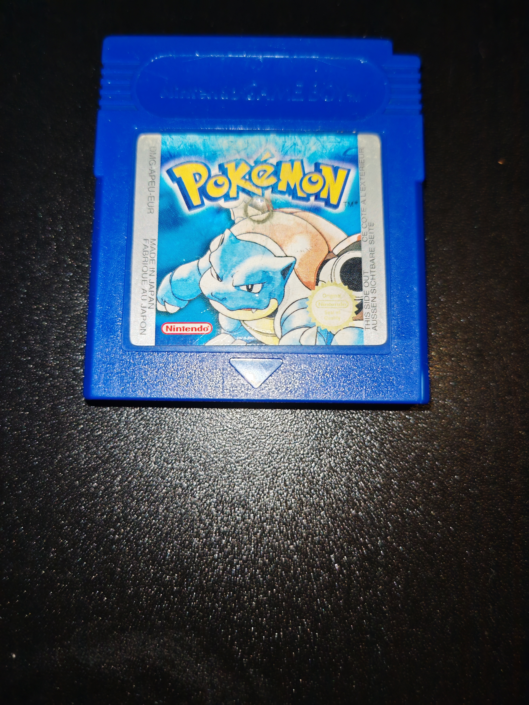
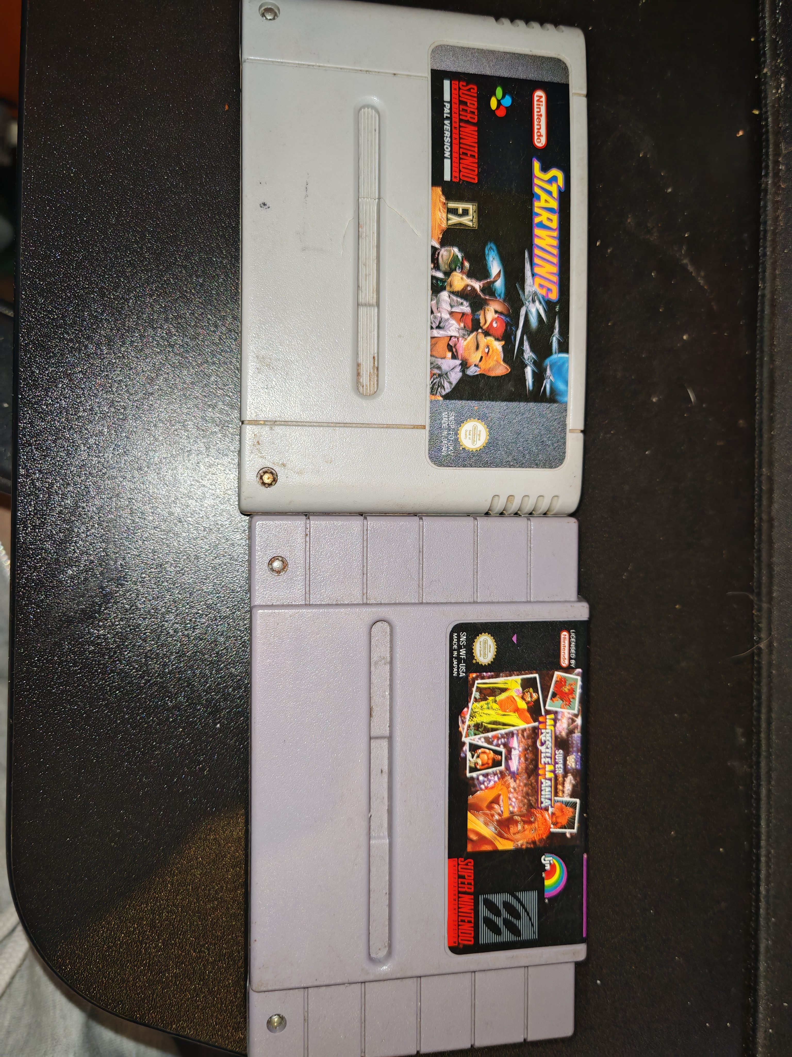
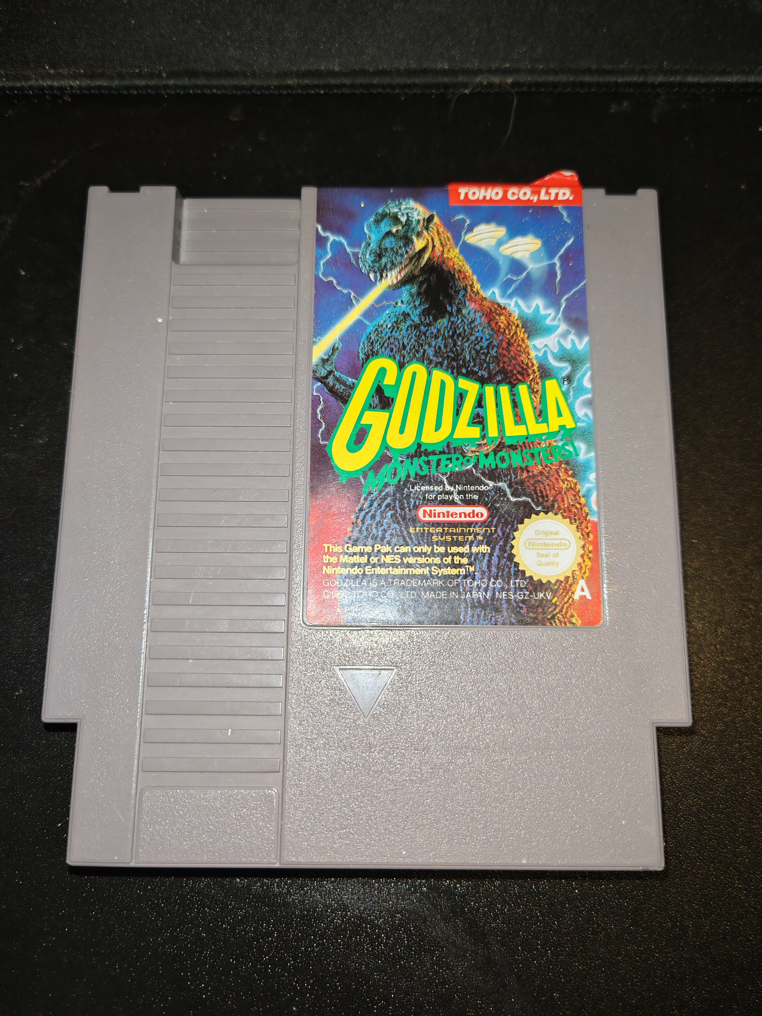
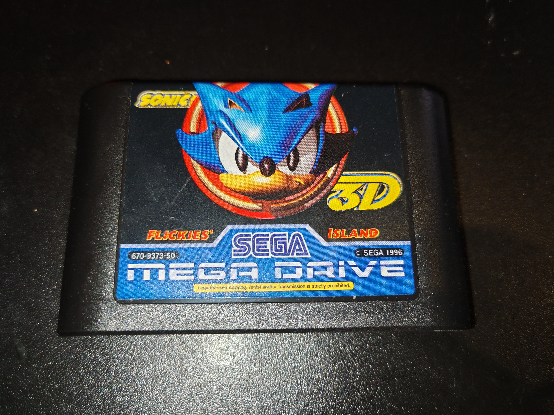

Slide 5
SCARAB Device
Modular Design
Cartridge Port Modules
Powered by Arduino Mega 2560
Dumps and Restores Save Data
Tests Pins
Validates Checksums
Tests Save Data Retention
Identifies Corruption

Slide 6
SCARAB PC Program
Interfaces with the SCARAB Device
GUI Based
Stores and Manages Save Data

Slide 7
Questions?

